Slide 1


GO! with Microsoft 365®
Excel 2025 Edition
Chapter 1
Creating a Worksheet and Charting Data
Copyright © 2026, 2023, 2020 Pearson Education, Inc. All Rights Reserved
Notes:
If this PowerPoint presentation contains mathematical equations, you may need to check that your computer has the following installed:
1) Math Type Plugin
2) Math Player (free versions available)
3) NVDA Reader (free versions available)
GO! With Microsoft 365
Excel 2025 Edition
Chapter 1: Creating a Worksheet and Charting Data

Slide 2
Learning Objectives (1 of 2)
1.1 Create, Save, and Navigate an Excel Workbook
1.2 Enter Data in a Worksheet
1.3 Construct and Copy Formulas and Use the SUM Function
1.4 Format Cells with Merge & Center, Cell Styles, and Themes
1.5 Chart Data to Create a Column Chart and Insert Sparklines
1.6 Print a Worksheet, Display Formulas, and Close Excel
Notes:
The objectives of this chapter are:
Create, Save, and Navigate an Excel Workbook
Enter Data in a Worksheet
Construct and Copy Formulas and Use the SUM Function
Format Cells with Merge & Center, Cell Styles, and Themes
Chart Data to Create a Column Chart and Insert Sparklines
Print a Worksheet, Display Formulas, and Close Excel

Slide 3
Learning Objectives (2 of 2)
1.7 Check Spelling in a Worksheet
1.8 Enter Data by Range
1.9 Construct Formulas for Mathematical Operations
1.10 Edit Values in a Worksheet
1.11 Format a Worksheet
Notes:
Additional objectives of this chapter are:
Check Spelling in a Worksheet
Enter Data by Range
Construct Formulas for Mathematical Operations
Edit Values in a Worksheet
Format a Worksheet

Slide 4
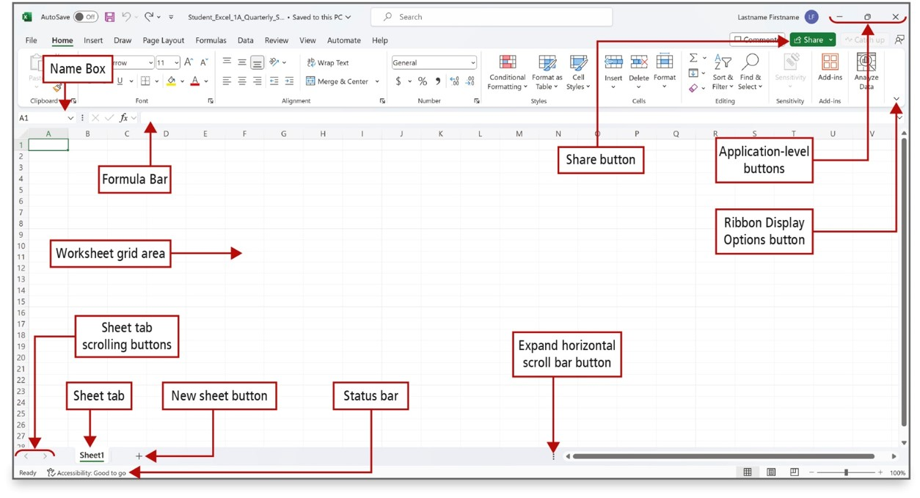
Create, Save, and Navigate an Excel Workbook (1 of 2)
Notes:
When you start Excel, a new blank workbook—the Excel file that stores your data—displays. A workbook contains one or more pages called a worksheet (also known as a spreadsheet). Worksheets are stored in a workbook and formatted as a pattern of uniformly spaced horizontal rows and vertical columns, the intersection of which is referred to as a cell.
Long Description:
In the excel sheet, the home tab is active. A share button, application-level buttons (minimize, maximize, and close buttons), and a ribbon display options button are at the top right portion of the sheet. A name box and a formula bar are below the menu options. A worksheet grid area is provided at the center of the sheet with sheet tab scrolling buttons, sheet tab, new sheet button, and status bar on the bottom left portion of the screen. Three dots in a vertical manner at the bottom right shows expanding horizontal scroll bar button.

Slide 5
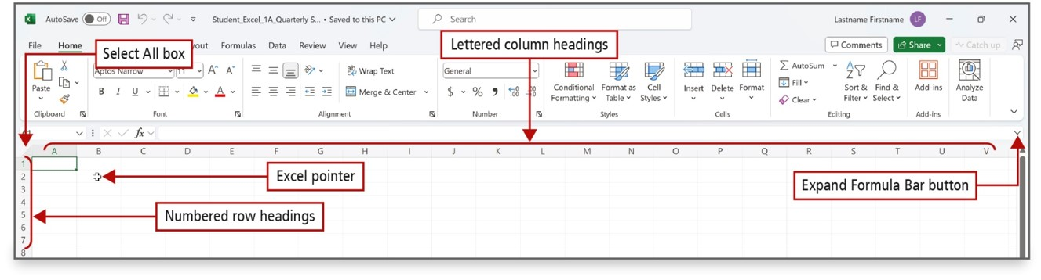
Create, Save, and Navigate an Excel Workbook (2 of 2)
Notes:
A column is a vertical group of cells in a worksheet. Each column heading is designated in alphabetical order—A, B, C, etc. After column Z, columns start with AA, AB, and so on.
A row is a horizontal group of cells. Row headings are designated by a unique number—1, 2, 3, etc.
Long Description:
In the excel sheet, the home tab is active. The numbered rows from 1 to 7 are labeled numbered row headings and the lettered columns from A to V are labeled lettered column headings. A plus shaped pointer is labeled excel pointer. All rows are selected and labeled select all box. A drop down option on a formula bar at the right is labeled expand formula bar button.

Slide 6
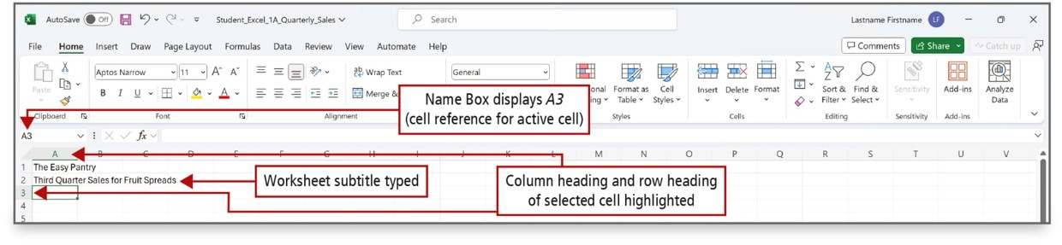
Enter Data in a Worksheet (1 of 6)
Notes:
Cell content, anything that you type in a cell, can be a constant value (referred to simply as a value) or a formula.
A formula is an equation that performs mathematical calculations on values in your worksheet.
The most used values are text values and number values. A text value is also referred to as a label.
A cell reference, also called a cell address, is the intersection of the column letter and row number.
Long Description:
The sheet has the title and subtitle entered in cells A 1 and A 2, respectively. A 3 is the active cell. The callouts are as follows: the Name Box: Name Box displays A 3 (cell reference for active cell); the worksheet subtitle Third Quarter Sales for Fruit Spreads: Worksheet subtitle typed; the highlighted row heading and column heading corresponding to the active cell: Column heading and row heading of selected cell highlighted.

Slide 7
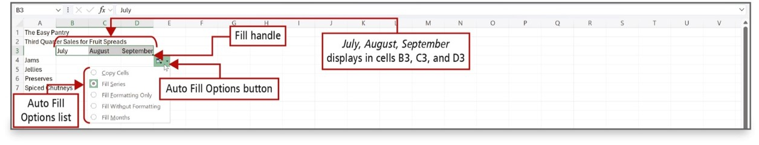
Enter Data in a Worksheet (2 of 6)
Notes:
The fill handle is a small square in the lower right corner of a selected cell. You can drag the fill handle to adjacent cells to fill the cells with values based on the first cell.
Auto Fill generates and extends a series of values into adjacent cells based on the value of other cells. The Auto Fill Options button displays options to fill the data.
Long Description:
In the excel sheet, July, August, September displays in cells B 3, C 3, and D 3. These 3 cells are in a box and labeled fill handle. A drop-down box opens with the following radio buttons: copy cells, fill series (selected), fill formatting only, fill without formatting, and fill months. All these radio buttons are labeled auto fill options list.

Slide 8
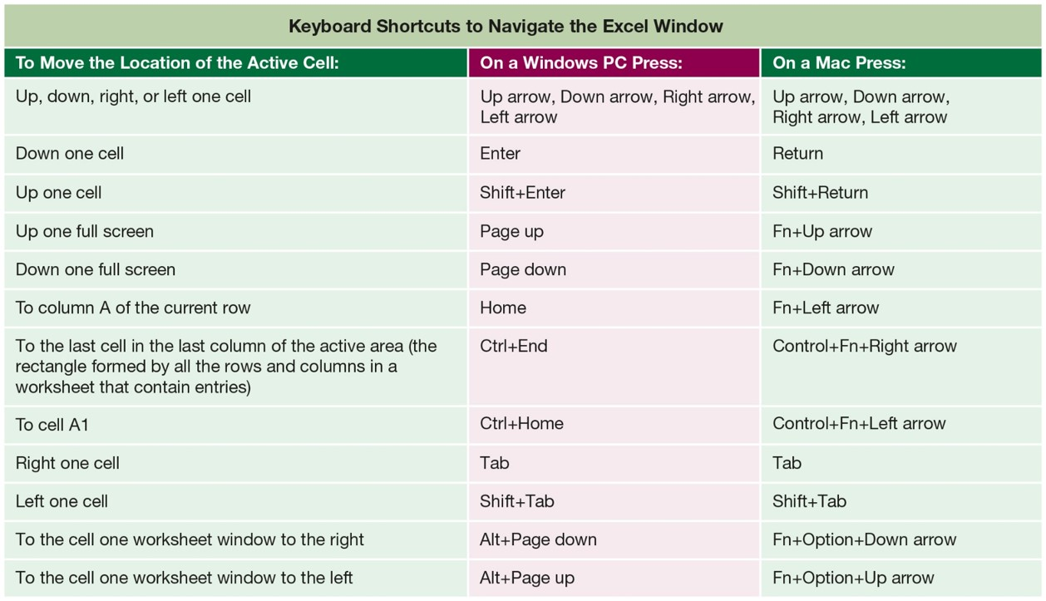
Enter Data in a Worksheet (3 of 6)
Notes:
Keyboard shortcuts can help you navigate a worksheet more efficiently. This table shows the Windows keys and key combinations.
Long Description:
The table consists of 3 columns and 12 rows. The column headings are as follows: Column 1: To move the location of the active cell. Column 2: On a window P C press. Column 3: On a Mac Press. The row entries are as follows: Row 1: Column 1: Up, down, right, or left one cell. Column 2: Up arrow, down arrow, right arrow, left arrow. Column 3: Up arrow, down arrow, right arrow, left arrow. Row 2: Column 1: Down one cell. Column 2: Enter. Column 3: Return. Row 3: Column 1: Up one cell. Column 2: Shift plus Enter. Column 3: Shift plus Return. Row 4: Column 1: Up one full screen. Column 2: Page up. Column 3: Function plus Up arrow. Row 5: Column 1: Down one full screen. Column 2: Page down. Column 3: Function plus down arrow. Row 6: Column 1: To column A of the current row. Column 2: Home. Column 3: Function plus left arrow. Row 7: Column 1: To the last cell in the last column of the active area (the rectangle formed by all the rows and columns in a worksheet that contain entries). Column 2: Control plus end. Column 3: Control plus Function plus right arrow. Row 8: Column 1: To cell A 1. Column 2: Control plus home. Column 3: Control plus function plus left arrow. Row 9: Column 1: Right one cell. Column 2: Tab. Column 3: Tab. Row 10: Column 1: Left one cell. Column 2: Shift plus tab. Column 3: Shift plus tab. Row 11: Column 1: To the cell one worksheet window to the right. Column 2: Alt plus page down. Column 3: Function plus option plus down arrow. Row 12: Column 1: To the cell one worksheet window to the left. Column 2: Alt plus page up. Column 3: Function plus option plus up arrow.

Slide 9
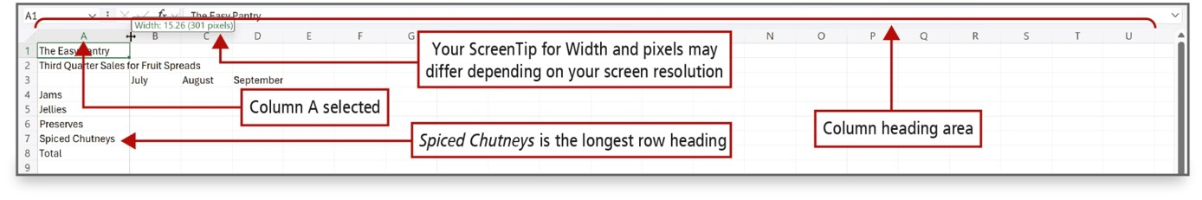
Enter Data in a Worksheet (4 of 6)
Notes:
In the figure, Spiced Chutneys is the longest row title in cells A4 through A8. The worksheet subtitle in cell A2 spans more than one column and still does not fit in column A.
You can adjust the column width to fit the widest heading in the column.
Long Description:
In the excel sheet, column A is labeled column A selected. Cell A 1 is selected. The width of column A has a text box that reads Width: 15.26 (301 pixels) and is labeled Your ScreenTip for Width and pixels may differ depending on your screen resolution. Cell A 7 with spiced chutneys is labeled Spiced chutneys is the longest row heading. Columns from A to U are labeled column heading area.

Slide 10
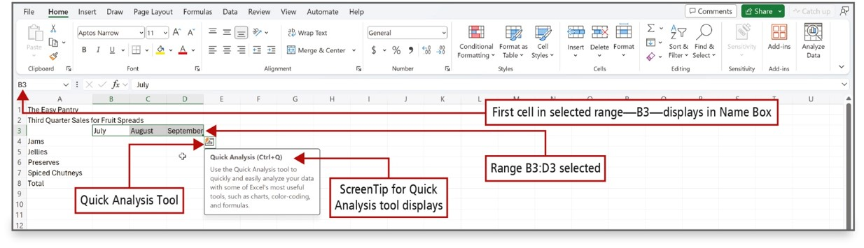
Enter Data in a Worksheet (5 of 6)
Notes:
A range is two or more cells on a worksheet that are adjacent or nonadjacent. When you see a colon between two cell references, the range includes all the cells between the two cell references.
The Quick Analysis tool displays in the lower right corner of the selected range, with which you can analyze your data by using Excel tools such as charts, color-coding, and formulas.
Long Description:
In the excel sheet, first cell in selected range - B 3 - displays in Name box. Cells B 3, C 3, and D 3 are labeled range B 3 colon D 3 selected. A box with a thunder icon is shown near D 3 and is labeled quick analysis tool. A text near the box reads as follows: Quick Analysis (Control plus Q): Use the quick analysis tool to quickly and easily analyze your data with some of Excel's most useful tools, such as charts, color-coding, and formulas. This text is labeled ScreenTip for Quick Analysis tool displays.

Slide 11
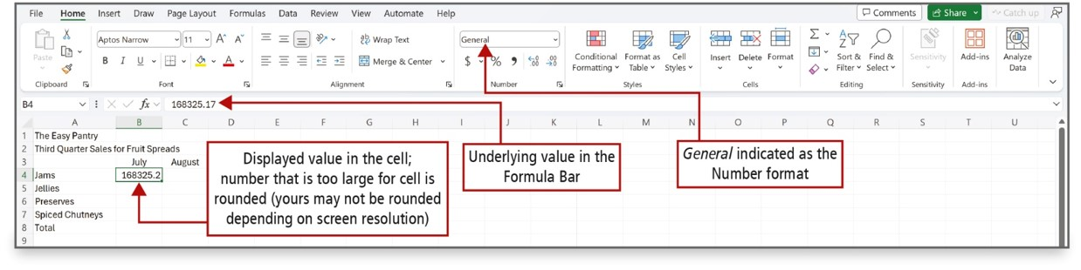
Enter Data in a Worksheet (6 of 6)
Notes:
Data that displays in a cell is the displayed value.
Data that displays in the Formula Bar is the underlying value. The number of digits or characters that display in a cell—the displayed value—depends on the width of the column. Calculations on numbers will always be based on the underlying value, not on the displayed value.
Long Description:
In the excel sheet, cell B 4 (selected) reads 168325.2 and is labeled: Displayed value in the cell; number that is too large for cell is rounded (yours may not be rounded depending on screen resolution). Formula bar reads 168325.2 and is labeled underlying value in the formula bar. A drop-down menu at the top pane has General selected and is labeled General indicated as the number format.

Slide 12
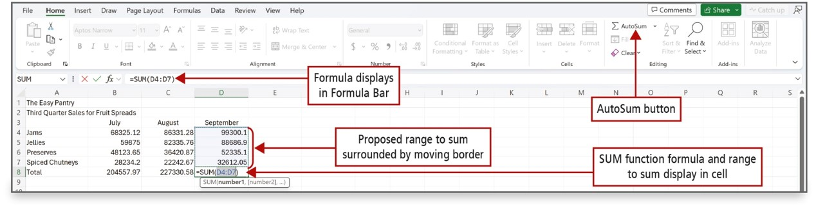
Construct and Copy Formulas and Use the SUM Function (1 of 3)
Notes:
A formula is an equation that performs mathematical calculations on values in other cells, and then places the result in the cell containing the formula. The result displays in the cell and the underlying formula displays in the Formula Bar.
A function is a prewritten formula that looks at one or more values, performs an operation, and then returns a value.
Long Description:
In the excel sheet, formula bar reads: equals SUM (D 4 colon D 7) and is labeled formula displays in formular bar. Cells D 4 to D 8 are labeled proposed range to sum surrounded by moving border. Cell D 8 with formula is labeled SUM function formula and range to sum display in cell. AutoSum button in the top pane is labeled.

Slide 13
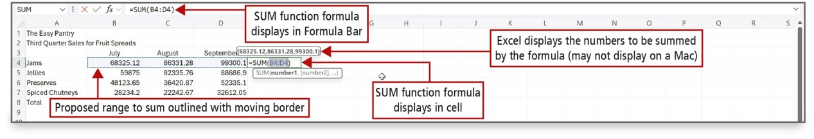
Construct and Copy Formulas and Use the SUM Function (2 of 3)
Notes:
The SUM function is an Excel function—a prewritten formula. In the SUM function shown above, the = sign signals the beginning of a formula or function, SUM indicates the type of calculation, and (B4:D4) indicates the range of cells on which the sum calculation will be performed.
Long Description:
In the excel sheet, cells B 4 to D 4 are labeled proposed range to sum outlined with moving border. Formula bar reads: equals SUM (B 4 colon D 4) and is labeled Sum function formula displays in formula bar. Cells B 4 to D 4 are selected and dragged to cell E 4 which reads equals SUM (B 4 colon D 4), labeled SUM function formula displays in cell. A text above reads, (68325.12, 86331.28, 99300.1) and is labeled excel displays the numbers to be summed by the formula (may not display on a Mac).

Slide 14
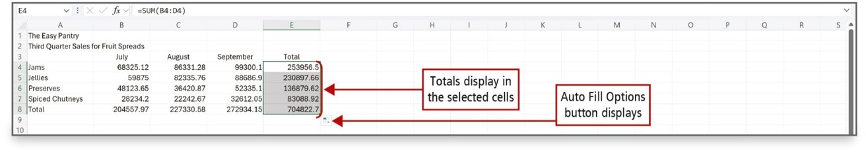
Construct and Copy Formulas and Use the SUM Function (3 of 3)
Notes:
When the fill handle is used to copy a cell containing a formula, the formula adjusts the cell references relative to the row number. This is called a relative cell reference—a cell reference based on the relative position of the cell that contains the formula and the cells referred to in the formula. The calculation is the same, but it is performed on the cells in that particular row.

Slide 15
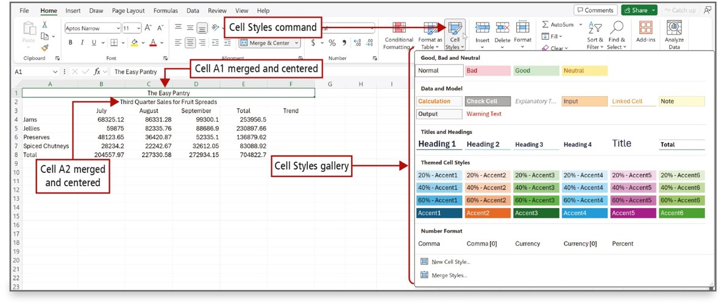
Format Cells with Merge & Center, Cell Styles, and Themes (1 of 4)
Notes:
Format commands change the appearance of cells to make a worksheet attractive and easy to read.
The Merge & Center command joins selected cells into one larger cell and centers the contents in the merged cell.
A cell style is a defined set of formatting characteristics, such as font, font size, font color, cell borders, and cell shading. The Cell Styles gallery is displayed in the figure, and cells A1 and A2 are merged and centered.
Long Description:
The Home tab is selected. The Cell Styles menu button next to the Number group on the ribbon is selected and the Cell Styles menu is open. A callout pointing to the Cell Styles menu reads, Cell Styles gallery. The Cell Styles gallery has five sections with style thumbnails: Good, Bad and Neutral; Data and Model; Titles and Headings; Themed Cell Styles; Number Format. A table in the sheet has the title from cells A1 to F1. A callout pointing to the merged cells A1 to F1 reads, Cell A1 merged and centered. The subtitle is from cells A2 to F2. A callout pointing to the merged cells A2 to F2 reads, Cell A 2 merged and centered.

Slide 16
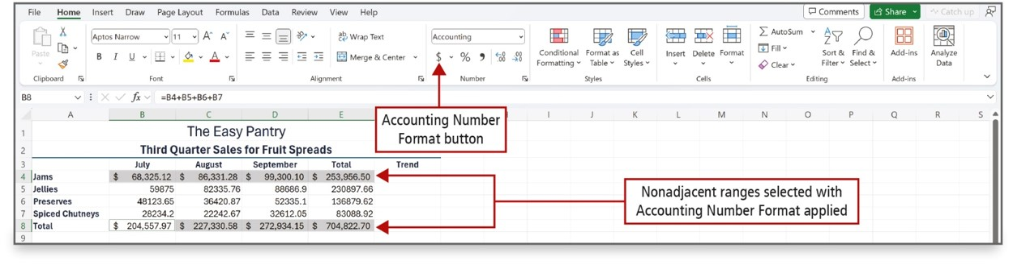
Format Cells with Merge & Center, Cell Styles, and Themes (2 of 4)
Notes:
When number values are typed into a cell, by default, they align at the right edge of the cell.
The default number format is the general format.
As shown on this slide, the Accounting Number Format applies a thousand comma separator where appropriate, inserts a fixed U.S. dollar sign aligned at the left edge of the cell, applies two decimal places, and leaves a small amount of space at the right edge of the cell to accommodate parentheses when negative numbers are present.

Slide 17
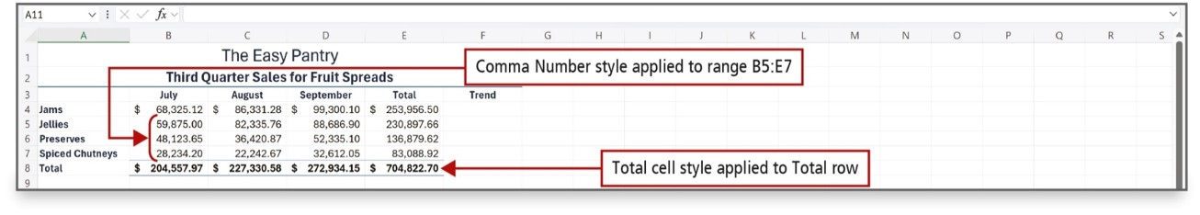
Format Cells with Merge & Center, Cell Styles, and Themes (3 of 4)
Notes:
The Comma Style inserts a thousand comma separator where appropriate and applies two decimal places.

Slide 18
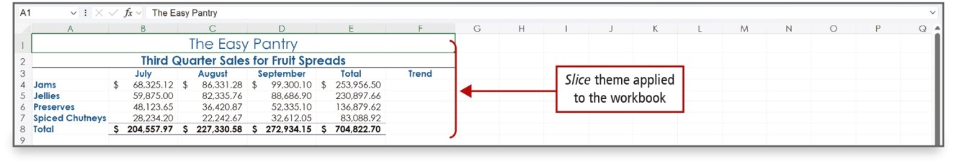
Format Cells with Merge & Center, Cell Styles, and Themes (4 of 4)
Notes:
A theme is a predefined set of colors, fonts, lines, and fill effects that coordinate for an attractive look.

Slide 19
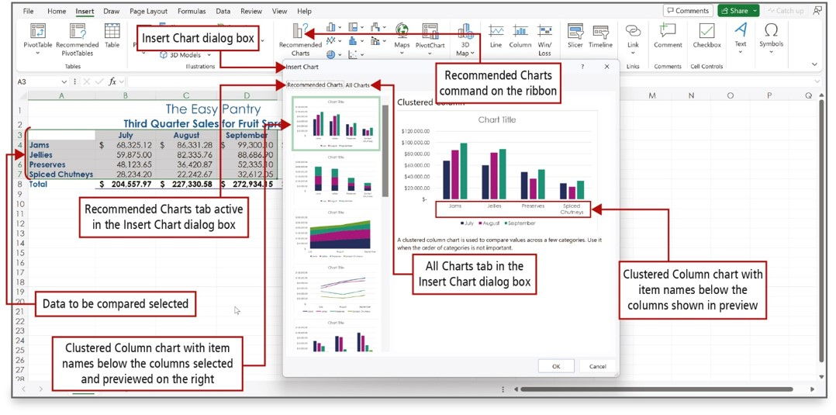
Chart Data to Create a Column Chart and Insert Sparklines (1 of 8)
Notes:
A chart is a graphic representation of data in a worksheet. Data in a chart is easier to understand than a table of numbers.
Recommended Charts is an Excel feature that displays a customized set of charts that, according to Excel’s calculations, will best fit your data.
A column chart is useful for illustrating comparisons among related numbers.
Long Description:
In the excel sheet, the table values are selected and labeled data to be compared is selected. Recommended charts command is on the ribbon. Insert dialog box is open with recommended charts tab active. All charts tab is in the insert chart dialog box. Clustered column chart with item names are below the columns selected and previewed on the right. Clustered column chart with item names are below the columns shown in preview.

Slide 20
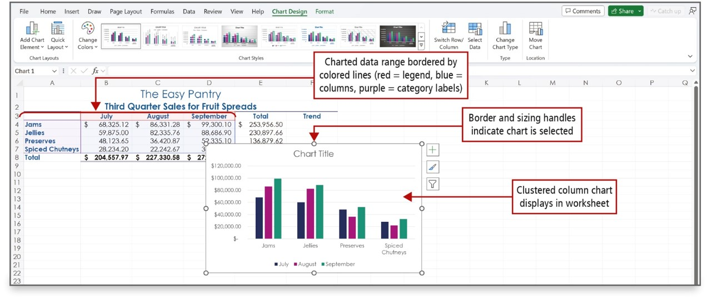
Chart Data to Create a Column Chart and Insert Sparklines (2 of 8)
Notes:
When a chart has been created and inserted, and is selected, border and sizing handles display. The Chart Design and Format contextual tabs display next to the standard tabs on the ribbon. In this example, a clustered column chart has been inserted into the worksheet and is selected.
Long Description:
In the excel sheet, the table values are selected and labeled charted data range bordered by colored lines (red equals legend, blue equals columns, purple equals category labels). A clustered column chart for the selected data is open and is labeled clustered column chart displays in worksheet. The border of the chart is labeled border and sizing handles indicate chart is selected.

Slide 21
Chart Data to Create a Column Chart and Insert Sparklines (3 of 8)
Chart components:
Category labels—labels that display along the bottom of the chart
Category axis or x-axis—area along the chart’s bottom
Identifies data categories
Value axis or y-axis—area along the left side of the chart
Includes a numerical scale on which the charted data is based
Legend—identifies the patterns or colors that are assigned to the categories in the chart
Notes:
Chart components:
Category labels are the labels that display along the bottom of the chart to identify the category of data.
Category axis or the x-axis is the area along the chart’s bottom.
Value axis or the y-axis is the area along the left side of the chart.
Excel includes a numerical scale on which the charted data is based. It appears along the lower edge of the chart.
A legend is a chart component that identifies the patterns or colors that are assigned to the categories in the chart.

Slide 22
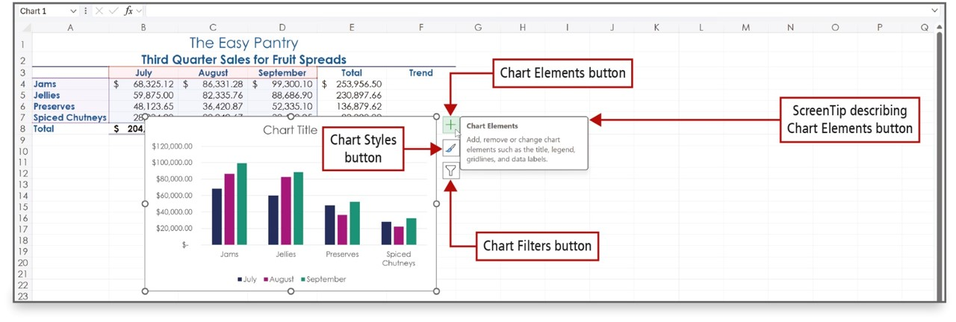
Chart Data to Create a Column Chart and Insert Sparklines (4 of 8)
Notes:
When a chart is selected, three buttons display to the right of the chart:
The Chart Elements button enables you to add, remove, or change chart elements such as the title, legend, gridlines, and data labels.
The Chart Styles button enables you to set a style or color scheme for your chart.
The Chart Filters button enables you to change which data displays in the chart.
Long Description:
In the excel sheet, the table values are selected. A clustered column chart for the selected data is open with a plus icon (labeled chart elements button), a paint brush icon (labeled chart styles button), and a filter icon (labeled chart filters button) on the top right corner. A text box near the chart elements reads: Chart Elements: Add, remove, or change chart elements such as the title, legend, gridlines, and data labels, and is labeled ScreenTip describing Chart Elements button.

Slide 23
Chart Data to Create a Column Chart and Insert Sparklines (5 of 8)
Data point—value that originates in a worksheet cell
Data marker—column, bar, area, dot, pie slice, or other symbol in a chart that represents a single data point
Data series—set of related data points
Chart layout—combination of chart elements including a title, legend, labels for the columns, and the table of charted cells
Notes:
A data point is a value that originates in a worksheet cell.
A data marker is a column, bar, area, dot, pie slice, or other symbol in a chart that represents a single data point.
A data series is a set of related data points.
A chart layout is a combination of chart elements, which can include a title, legend, labels for the columns, and the table of charted cells.

Slide 24
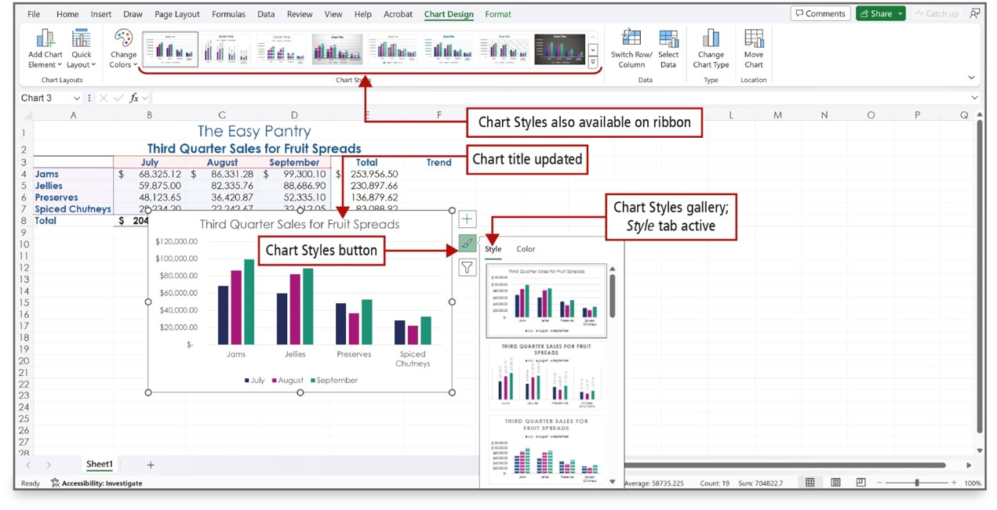
Chart Data to Create a Column Chart and Insert Sparklines (6 of 8)
Notes:
The Chart Styles gallery displays an array of predefined chart styles—the overall visual look of a chart in terms of its colors, backgrounds, and graphic effects.
Long Description:
In the excel sheet, a clustered column chart for the selected data of the table is open with chart title updated. The chart styles are also available on the ribbon. The chart styles button is selected with a box that has style (labeled chart styles gallery; style tab active) and color of charts. The first style is selected.

Slide 25
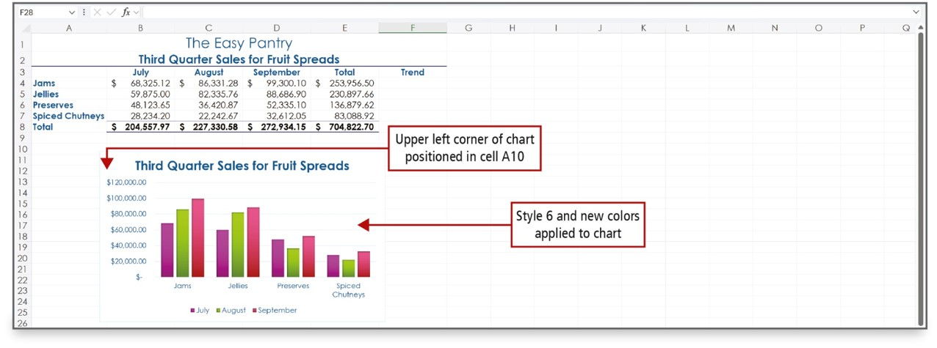
Chart Data to Create a Column Chart and Insert Sparklines (7 of 8)
Notes:
In the figure, Chart Style 6 has been applied and uses a white background, formats the columns with the theme colors selected, and applies a slight shadowed effect to the columns. The chart colors have been changed, and the chart has been positioned in cell A10.
Long Description:
The title reads, The Easy Pantry. The table titled Third Quarter Sales for Fruit Spreads includes sales expenses for fruit spreads for July to September and the Total and Trend columns. The column bar chart is also titled Third Quarter Sales for Fruit Spreads. The X-axis lists categories such as Jams, Jellies, Preserves, and Spiced Chutneys. There are three colored bars in each category. The Y-axis ranges from 20,000.00 dollars to 120,000.00 dollars in increments of 20,000.00 dollars. A callout pointing to the Y-axis scale reads, Upper left corner of chart positioned in cell A 10. A callout pointing to the chart area reads, Style 6 and new colors applied to chart.

Slide 26
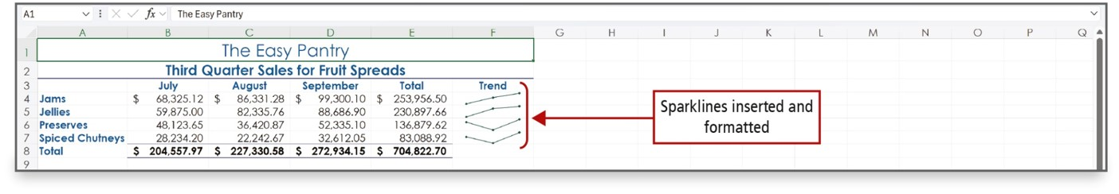
Chart Data to Create a Column Chart and Insert Sparklines (8 of 8)
Notes:
Sparklines are tiny charts embedded in a cell that give a visual trend summary alongside your data. A sparkline makes a pattern more obvious to the eye. By creating sparklines, you provide a context for your numbers. Your readers will be able to see the relationship between a sparkline and its underlying data quickly.

Slide 27
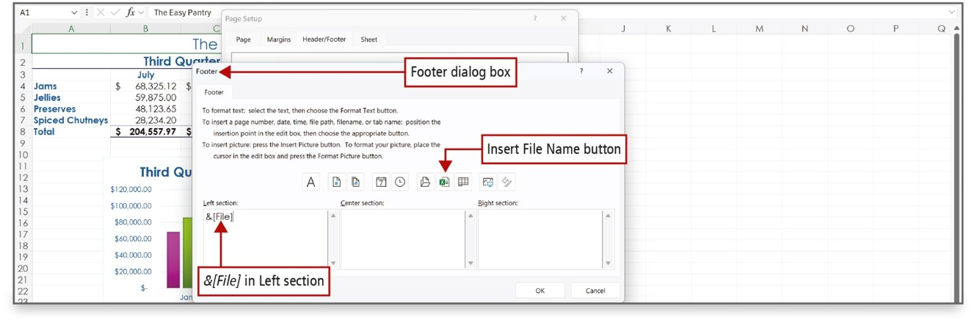
Print a Worksheet, Display Formulas, and Close Excel (1 of 4)
Notes:
Using the Header/Footer tab on the Page Setup dialog box, you can add headers or footers to a printed worksheet.

Slide 28
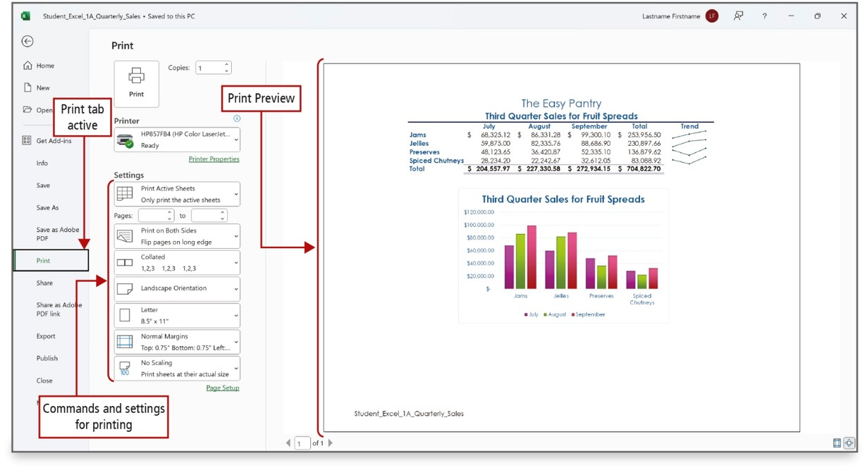
Print a Worksheet, Display Formulas, and Close Excel (2 of 4)
Notes:
Always pay attention to the Print Preview of a worksheet so you know how your document will print prior to sending it to the printer.
Long Description:
The print tab is active and the commands and settings for printing are to the right of the menu options. A print preview pane displays the table and a clustered column chart for the selected data in the table.

Slide 29
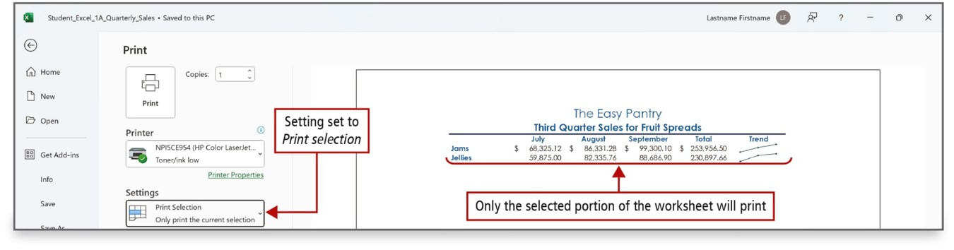
Print a Worksheet, Display Formulas, and Close Excel (3 of 4)
Notes:
One of the printing options is to print just the selected portion of worksheet by changing the setting to Print selection.

Slide 30
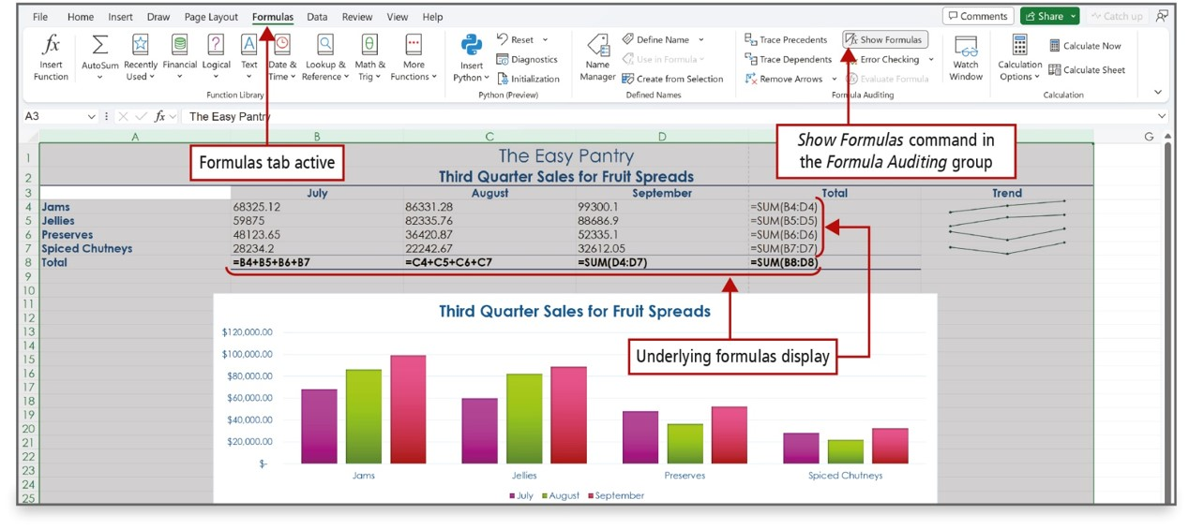
Print a Worksheet, Display Formulas, and Close Excel (4 of 4)
Notes:
The Show Formulas command is used to display the formula in each cell instead of the resulting value. You can toggle the display of formulas on or off using the Show Formulas button.

Slide 31
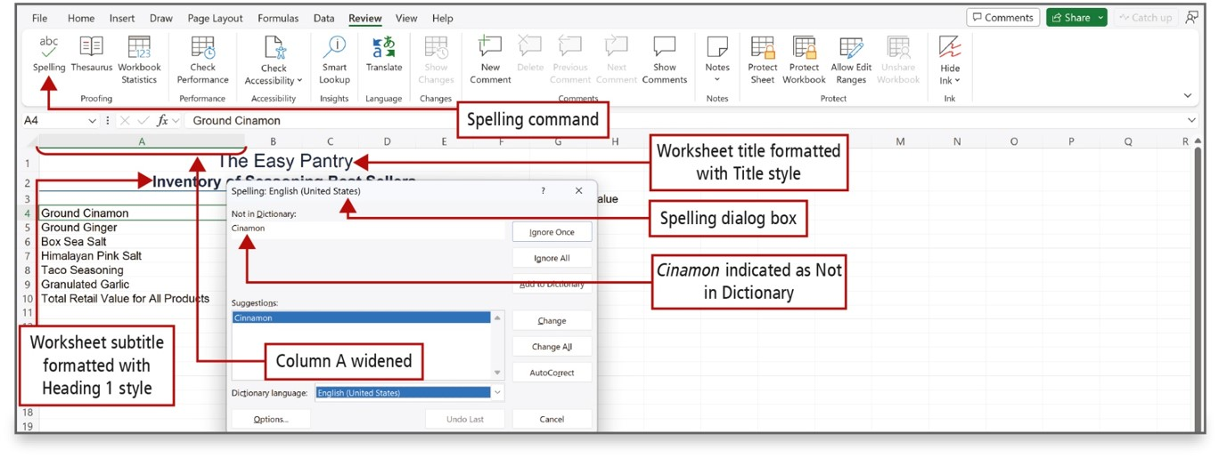
Check Spelling in a Worksheet
Notes:
In Excel, the spelling checker performs similarly to the other Microsoft 365 programs. Since the spelling checker searches from top to bottom, start in cell A1 and click Spelling on the Review tab, or press F7.
Long Description:
Spelling command is labeled. Worksheet title is formatted with title style. Worksheet subtitle is formatted with heading 1 style. Column A is widened. Spelling dialog box is open with cinnamon indicated as not in dictionary.

Slide 32
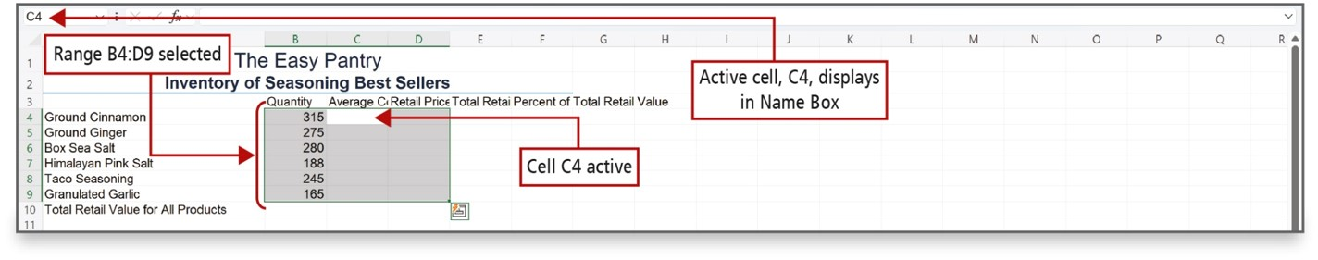
Enter Data by Range
Notes:
Data entry can be time consuming, but there is a time-saving technique in Excel. You first select the range of cells, and then you enter the data. After you enter the last value and press Enter, the active cell moves to the top of the next column within the selected range. Data entry in this manner is not required, but it can save you a lot of time because it confines the movement of the active cell to the selected range.

Slide 33
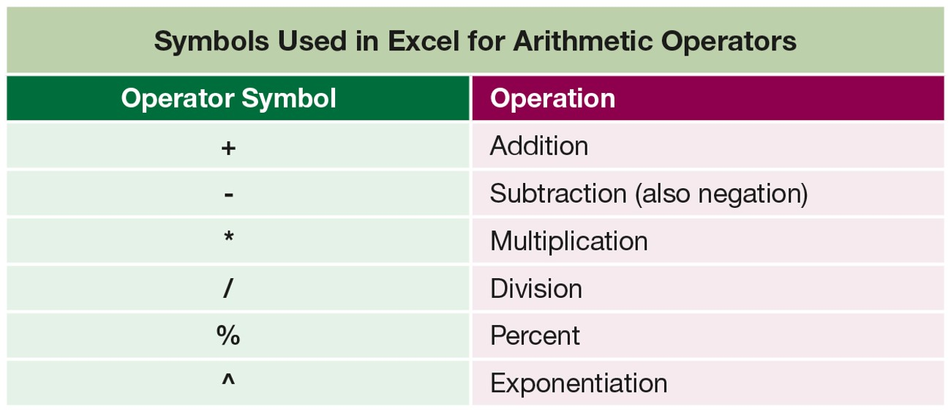
Construct Formulas for Mathematical Operations (1 of 3)
Notes:
Operators are symbols with which you can specify the type of calculation you want to perform in a formula.
Long Description:
The table consists of 2 columns and 6 rows. The column headings are as follows: Column 1: Operator symbol. Column 2: Operation. The row entries are as follows: Row 1: Column 1: plus. Column 2: Addition. Row 2: Column 1: minus. Column 2: Subtraction (also negation). Row 3: Column 1: asterisk. Column 2: Multiplication. Row 4: Column 1: slash. Column 2: Division. Row 5: Column 1: percent. Column 2: Percent. Row 6: Column 1: power of. Column 2: Exponentiation.

Slide 34
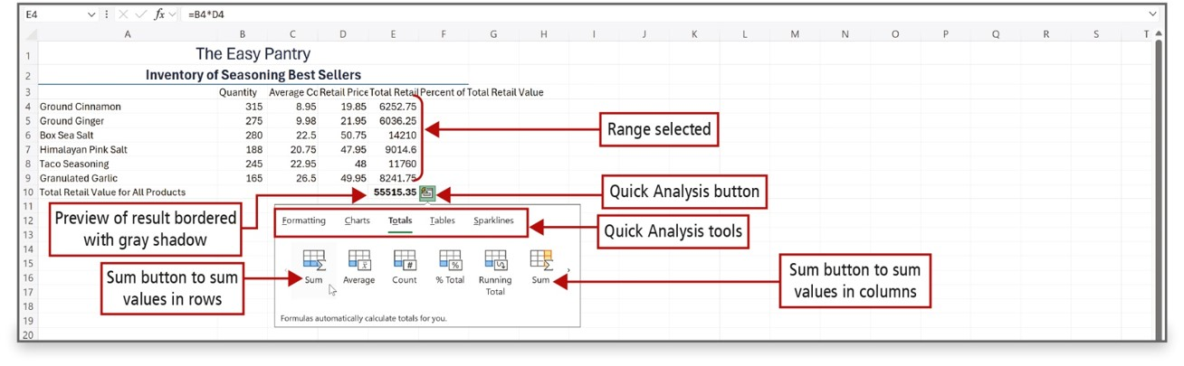
Construct Formulas for Mathematical Operations (2 of 3)
Notes:
The Quick Analysis button displays when you select a range of data; it contains common commands. On this slide, the shaded cells on the button indicate what will be summed and where the result will display, and a preview of the result displays in the cell bordered with a gray shadow.
Long Description:
In the excel sheet, cells E 4 to E 9 are labeled range selected. Cell E 10 is labeled preview of result bordered with gray shadow. A box, labeled quick analysis button, near E 10 opens a box with the following quicky analysis tools: Formatting, Charts, Totals, Tables (selected), and Sparklines. Below the tools, the following are shown: Sum, average, count, percent total, running total, and sum. The first sum button is to sum values in rows and the last sum button is to sum values in columns.

Slide 35
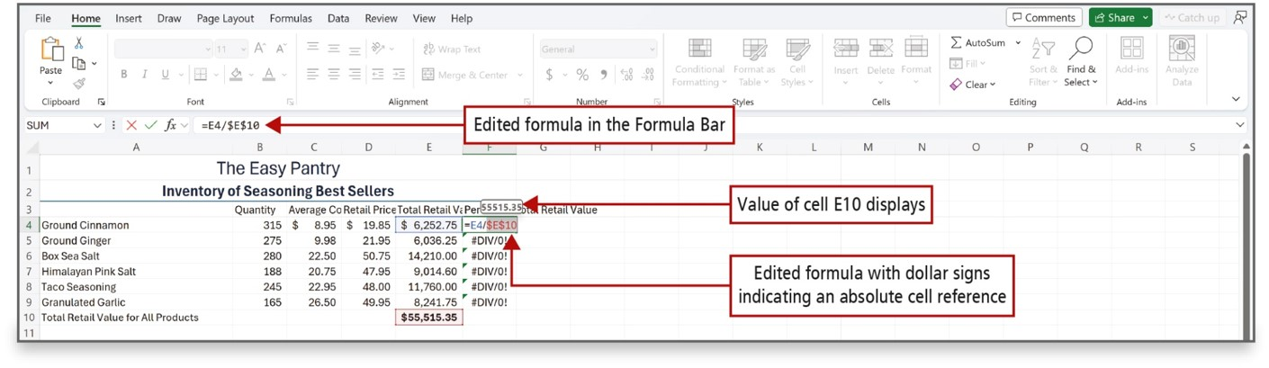
Construct Formulas for Mathematical Operations (3 of 3)
Notes:
A relative cell reference refers to a cell by its position relative to the cell that contains the formula. A relative cell reference automatically adjusts when a formula is copied, but in some calculations, you need a cell reference to remain fixed when copied.
An absolute cell reference, on the other hand, refers to a cell by its fixed position in the worksheet.
By changing the cell reference to an absolute reference in column F in the top figure, the error is eliminated in the results in the bottom figure.
Long Description:
In the excel sheet, formula bar reads equals E 4 divided by dollars E dollars 10 and is labeled edited formula in the formula bar. Cell F 4 is labeled edited formula with dollars signs indicating an absolute cell reference. Value of cell E 10 is displayed in a ScreenTip above cell F 4.

Slide 36
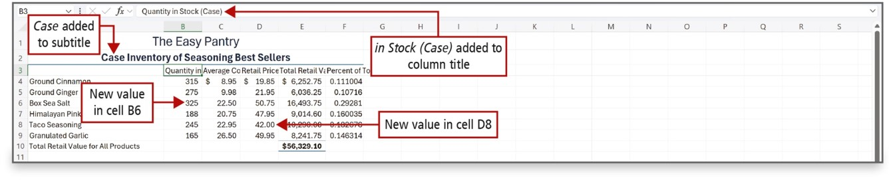
Edit Values in a Worksheet (1 of 2)
Notes:
Excel formulas are recalculated if you change the value in a cell that is referenced in this formula. Simply start typing the new value and it will replace the old value, and the formula will recalculate automatically. If text is too long to fit in a cell and the cell to the right contains data, the text is truncated—cut off—but the entire value still exists as the underlying value.
Long Description:
In the excel sheet, formula bar reads Quantity in Stock (case) and is labeled in stock (case) added to column title. Case is added to subtitle. New value in cells B 6 and D 8.

Slide 37
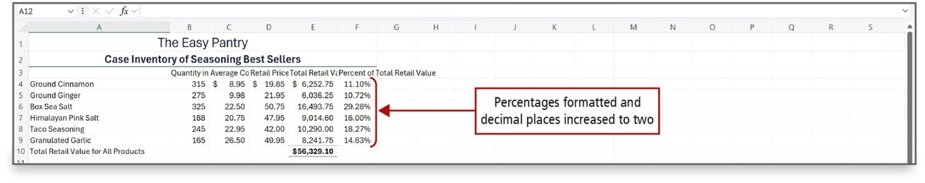
Edit Values in a Worksheet (2 of 2)
Notes:
A percentage is part of a whole expressed in hundredths. Percent Style may not offer a percentage precise enough to analyze important financial information—adding additional decimal places to a percentage makes data more precise.

Slide 38
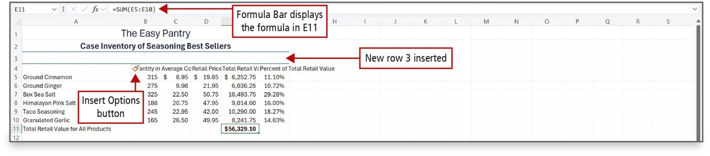
Format a Worksheet (1 of 3)
Notes:
Formatting refers to the process of specifying the appearance of cells and the overall layout of your worksheet. Columns and rows can be added and/or deleted, column widths can be adjusted, headings can be wrapped in cells, alignment, colors, and styles can be changed, and headers or footers can be added.

Slide 39
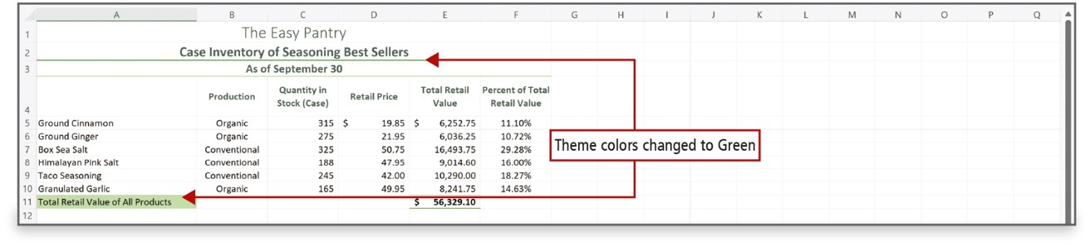
Format a Worksheet (2 of 3)
Notes:
You can change the theme colors of a workbook without changing the theme fonts or effects.

Slide 40
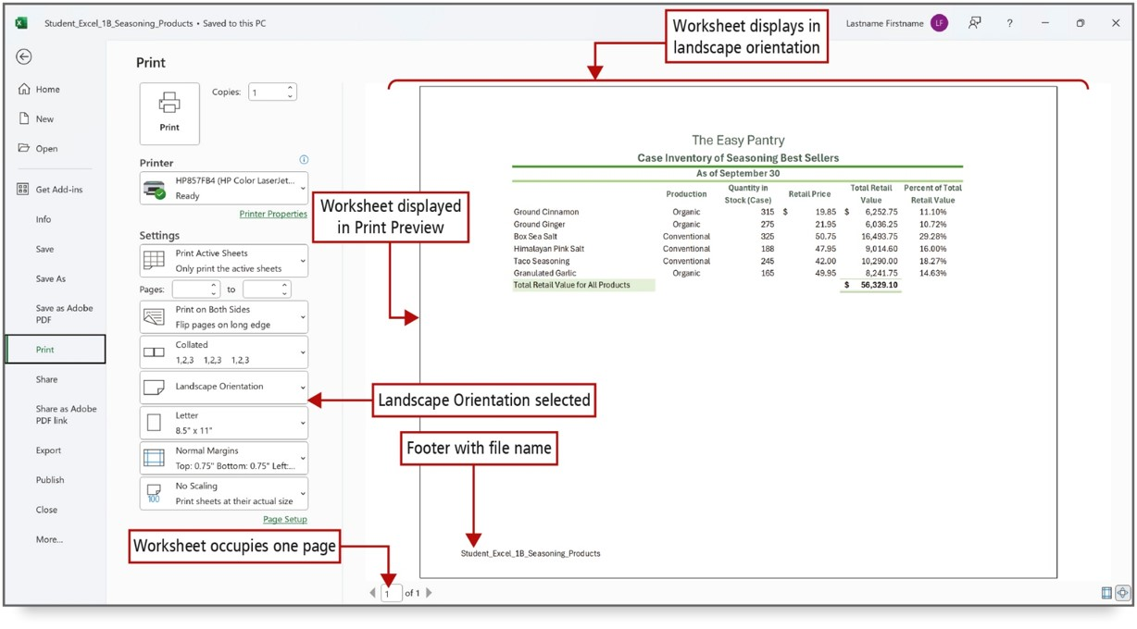
Format a Worksheet (3 of 3)
Notes:
You can change the orientation on the Page Layout tab, or here, in Print Preview. Because you will often see adjustments that need to be made in Print Preview, commonly used settings display on the Print tab in Backstage view.
Long Description:
The commands and settings for printing are to the right of the menu options with landscape orientation selected. A print preview pane displays the table titled The Easy Pantry, Case Inventory of Seasoning best Sellers, As of September 30. The preview pane is labeled worksheet displays in landscape orientation and worksheet displayed in print preview. The footer with file name is at the bottom of the preview pane. Worksheet occupies one page and is labeled 1 by 1 at the bottom of the preview pane.

Slide 41

Questions

Slide 42

Copyright
This work is protected by United States copyright laws and is provided solely for the use of instructors in teaching their courses and assessing student learning. Dissemination or sale of any part of this work (including on the World Wide Web) will destroy the integrity of the work and is not permitted. The work and materials from it should never be made available to students except by instructors using the accompanying text in their classes. All recipients of this work are expected to abide by these restrictions and to honor the intended pedagogical purposes and the needs of other instructors who rely on these materials.

